Slide 1
HOTEL MANAGEMENT SYSTEM
Database Theory Apps Final Project Report
CS 5200
CRN- 11813
Technical Lead-Karishma Grace Pappu (700759388)
Database Developer-Cherkuri Vandana (700759337)
Database Developer- Uma Maheshwar Rao Dhinthakurthy(700754030)
Frontend Developer-Vadluri Sai Sankeerthana (700757550)
Backend Developer-Singamsetti Ram Sandeep Kumar (700759940)
Backend Developer-Jilani Shaik (700768888)

Slide 2
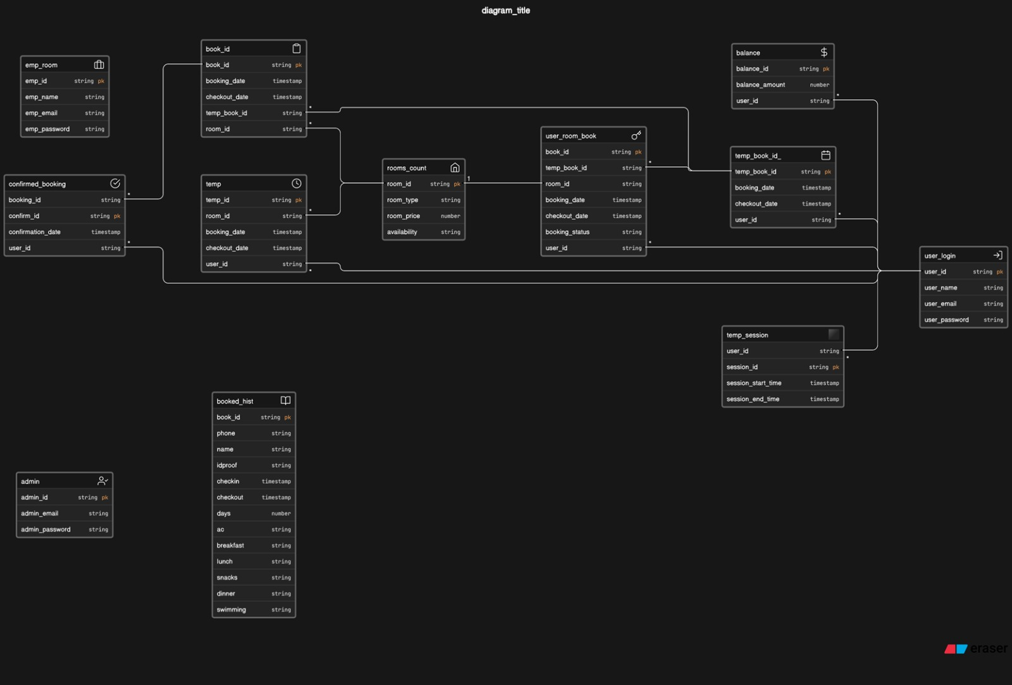
DATABASE DESIGN

Slide 3
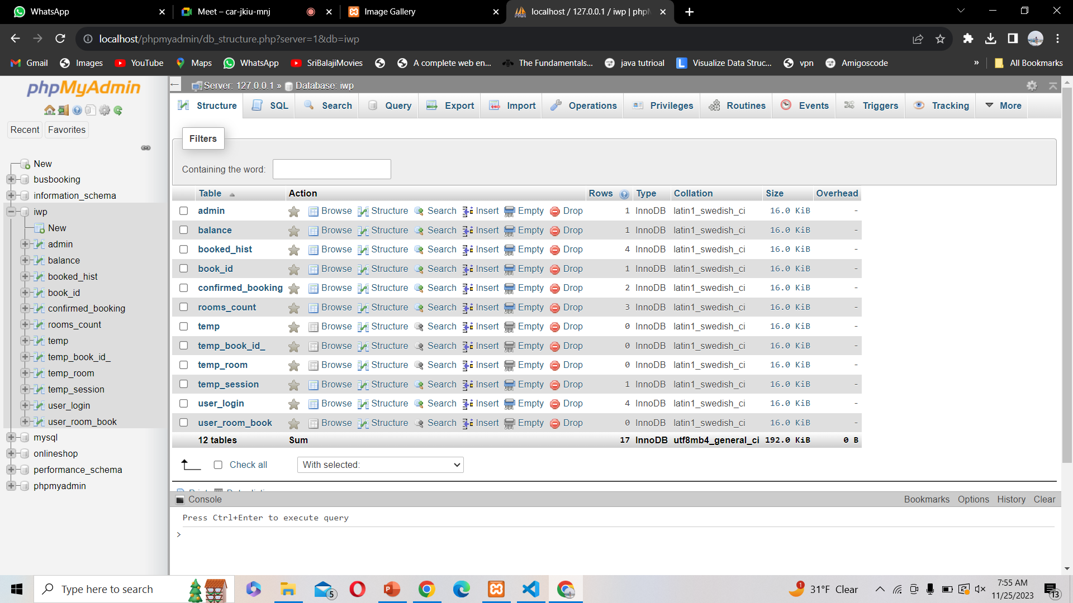
DATABASE WORKBENCH

Slide 4
BACK-END IMPLEMENTATION
Creating a database structure, writing PHP scripts to manage user interactions, and integrating with third-party APIs for payment processing and other features are all part of implementing a hotel management system backend with PHP and MySQL. This is a summarized summary of the procedure:
Database Structure: Create a MySQL database schema to hold all necessary data, such as hotel specifics, room kinds and availability, visitor details, bookings, and payments. Make tables and specify the relationships between each entity.
User Authentication: To handle user registration, login, and access control, implement user authentication with PHP and MySQL. Build a safe login process that validates and hashes passwords.
Payment processing: To securely handle online payments, integrate with a third-party payment processing gateway like PayPal or Stripe. To establish a connection with the gateway and handle transactions, use PHP libraries or APIs.

Slide 5
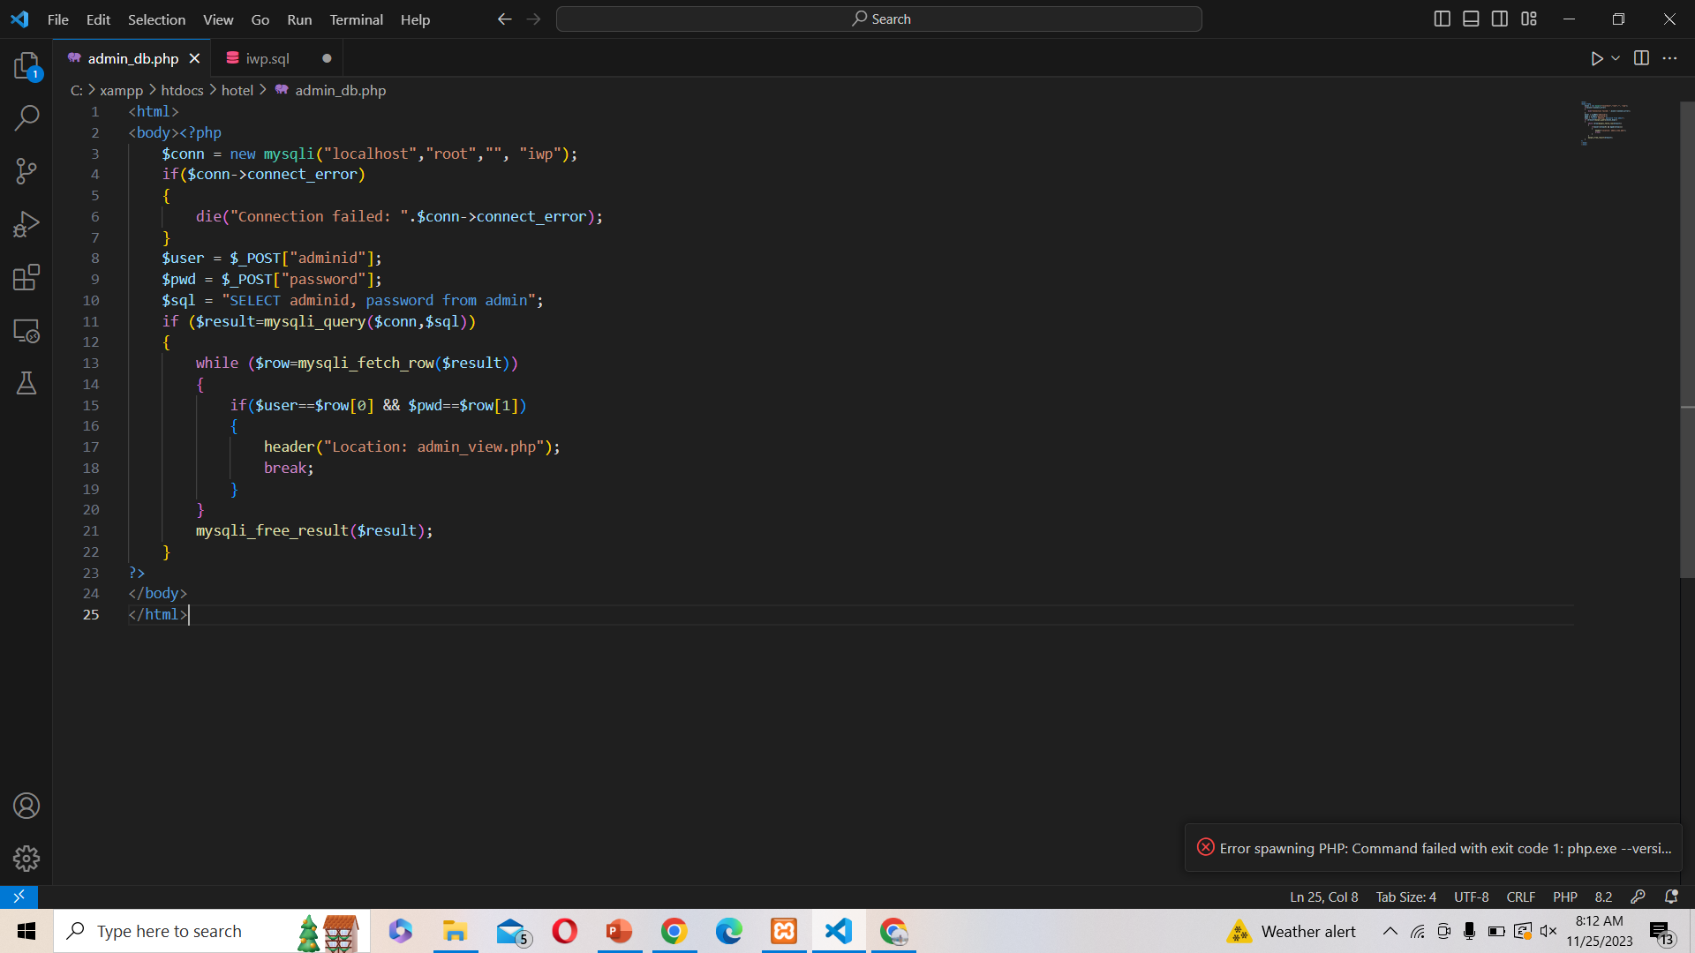
BACK-END CODE SCREENSHOT

Slide 6
FRONT-END IMPLEMENTATION
Using HTML, CSS, and JavaScript, a front-end implementation of a hotel management system creates a responsive and user-friendly interface for guest interactions and operation management. Here's a summary of the essential elements:
Homepage: Create a beautiful and informative homepage that highlights the hotel's offerings, services, and contact details. To make a layout that is visually attractive and compatible with a variety of devices, use CSS.
Room Listing: Create a dynamic page that lists available rooms according to the dates and type of rooms that are selected. To manage user interactions, filter rooms, and update the listing appropriately, use JavaScript.
Room details: Provide full details about each room, including pictures, features, costs, and availability, on thorough room pages. To organize the content, use HTML, and to style the layout, use CSS.
User Login: Using CSS styles and HTML elements. Use JavaScript to validate user input, verify that the password and username are empty, and, if required, display error messages. To validate user credentials, log users in, and reroute users to the dashboard, send an AJAX request to the backend server.

Slide 7
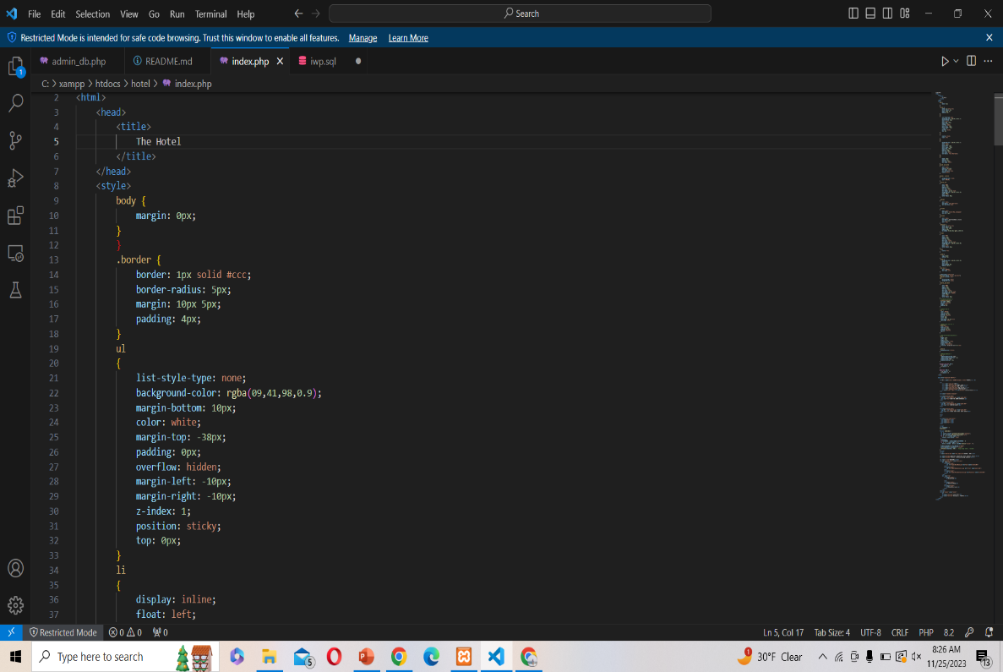
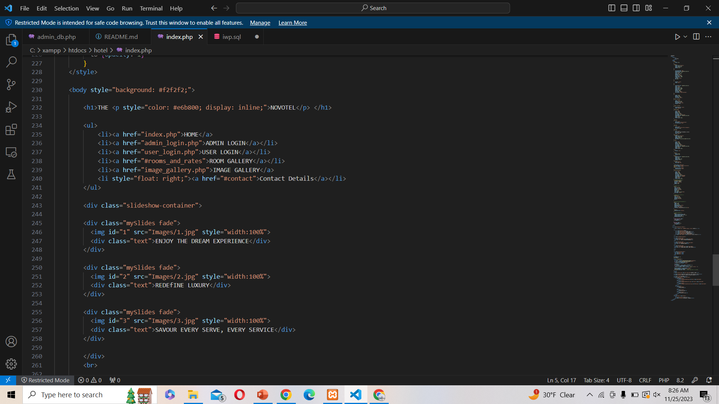
FRONT-END CODE SCREENSHOT

